Slide 1
Connect Four
C2C John Terragnoli

Slide 2
Embedded System
I built an embedded system which acts as a Connect Four Game for 2 players.
Use buttons on computer chip or remotes to move and drop pieces
Game displayed on standard TV or monitor via HDMI cable

Slide 3
Need
Board Game companies are eager to keep up with technological advances. Digitalizing them to be played with common-house items allows Board Games to stay relevant.

Slide 4
Level-0 Description
Inputs | Remote IR signal, directional and select buttons are required.
Outputs | A monitor will display a grid of the game. Different squares in the grid will be filled in with the appropriate color when a player chooses to place a piece there.
Behavior | Should decode the IR signals, determine if it is a viable move or not, determine which rectangle should be lit up, determine if the player has won the game or not, and end the game if it has. Required functionality is to get the program to work using the buttons on the FPGA. B Functionality is to use one remote to play the game. A Functionality is to have two remotes, one for each player, to play the game.

Slide 5
Videos

Slide 6
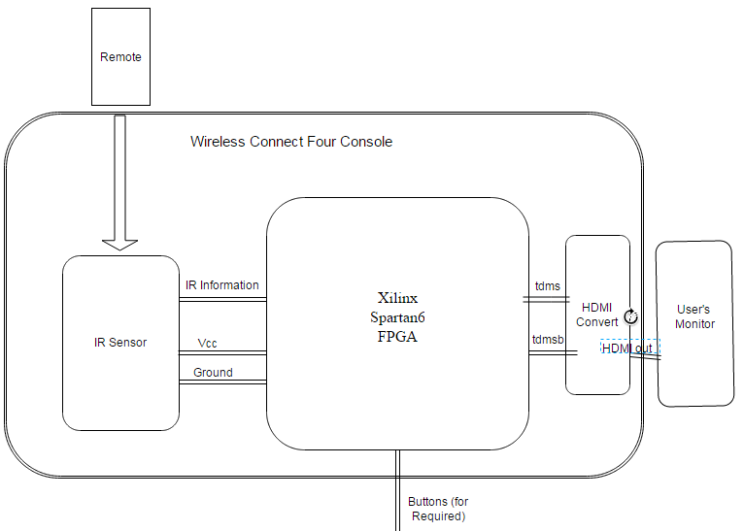
Level-1 Architecture

Slide 7
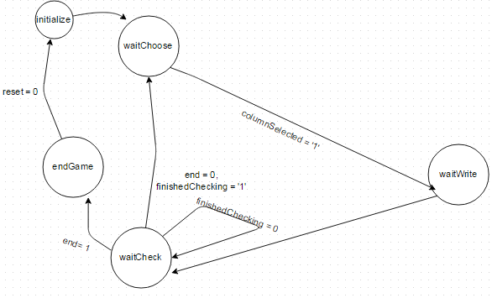
Control Unit

Slide 8
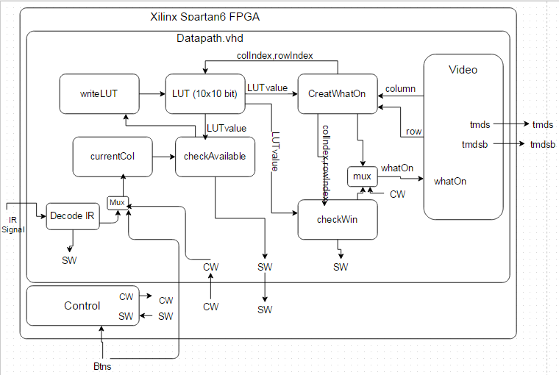
Datapath

Slide 9
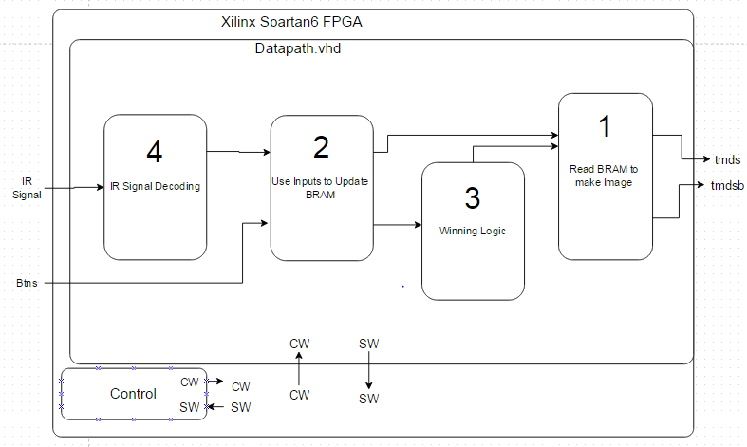
Idea Datapath
Note: Numbers reference order of creation

Slide 10
1: BRAM to Video
Drawing Basics
Counters used to count through row and column of pixels on display
Based on the pixel address, a specific color is sent to that pixel on the screen. In total an image is drawn

Slide 11
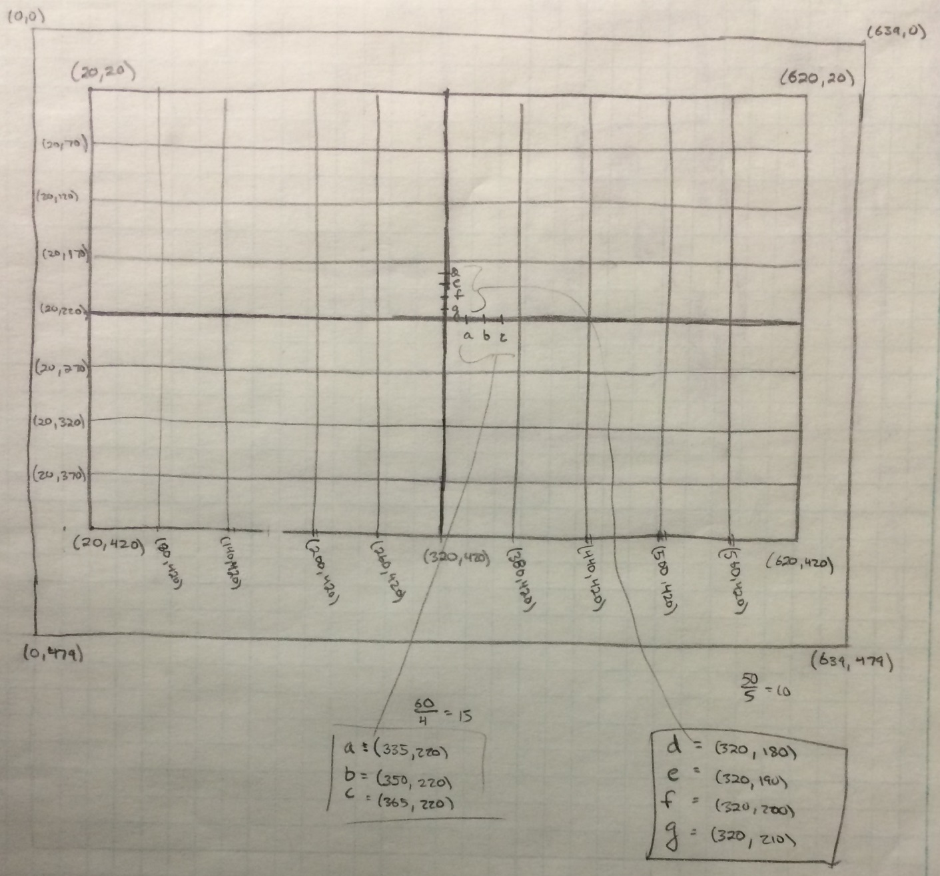
BRAM to Video
Screen Dimensions

Slide 12
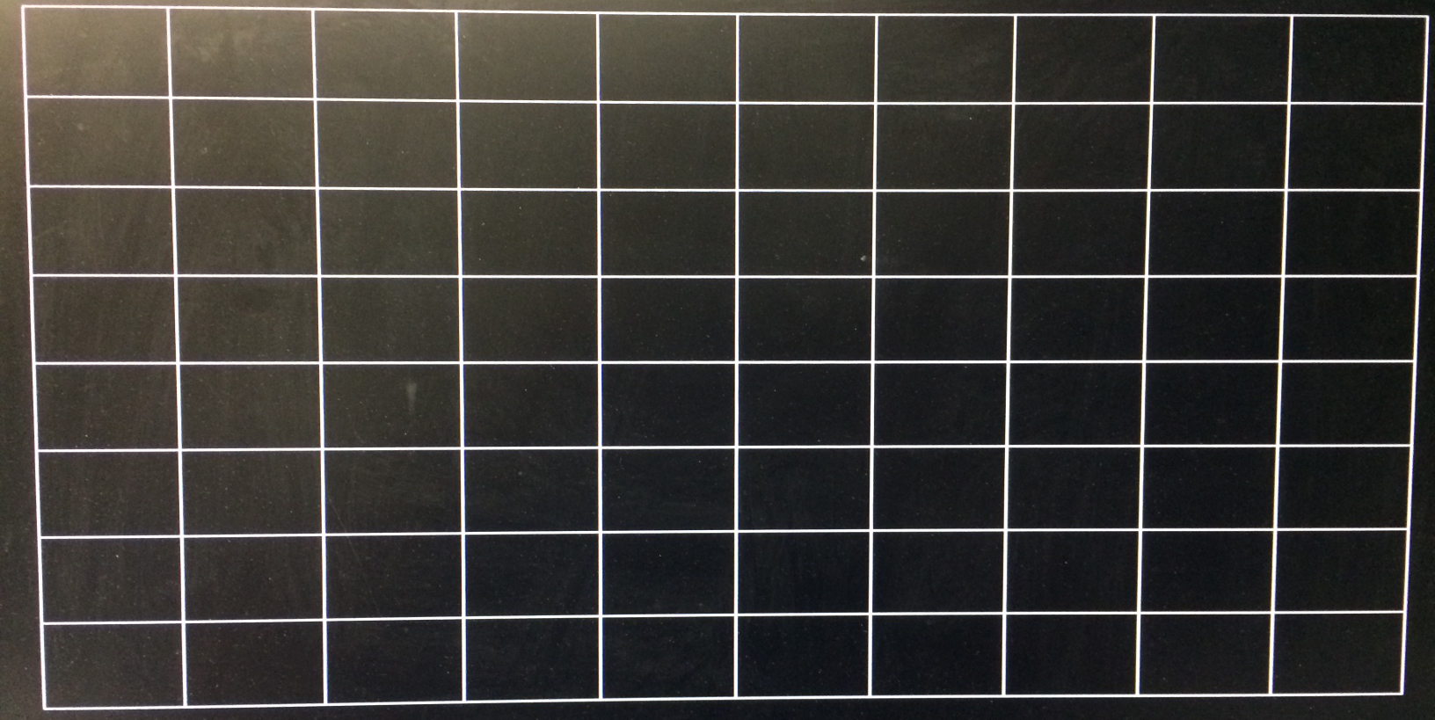
BRAM to Video
Initial, Static Board

Slide 13
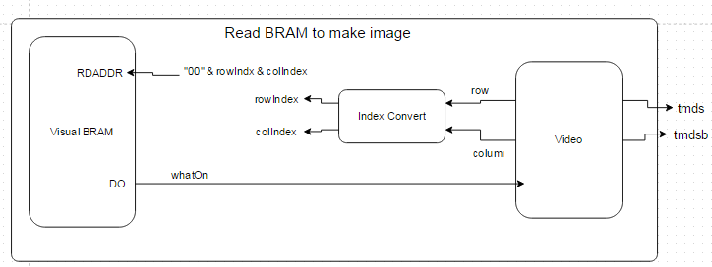
BRAM to Video
whatOn: 2 bits long, designates color of pixel being referenced
00: black (empty)
01: blue
10: red

Slide 14
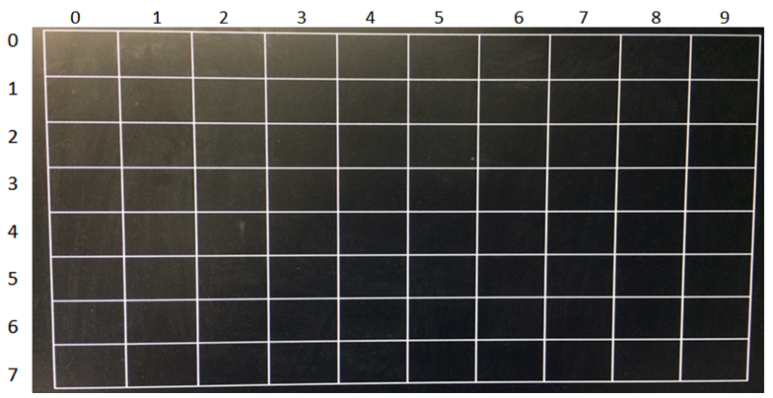
BRAM to Video
Indexes Labeled

Slide 15
BRAM to Video
Every (row,column) coordinate is associated with a (rowIndex, colIndex).
RDADDR <= “00” & rowIndex & colIndex
Each address associated with a color
When “Video” is writing to a specific (row, column) address, the color store at specific index is written to that pixel

Slide 16
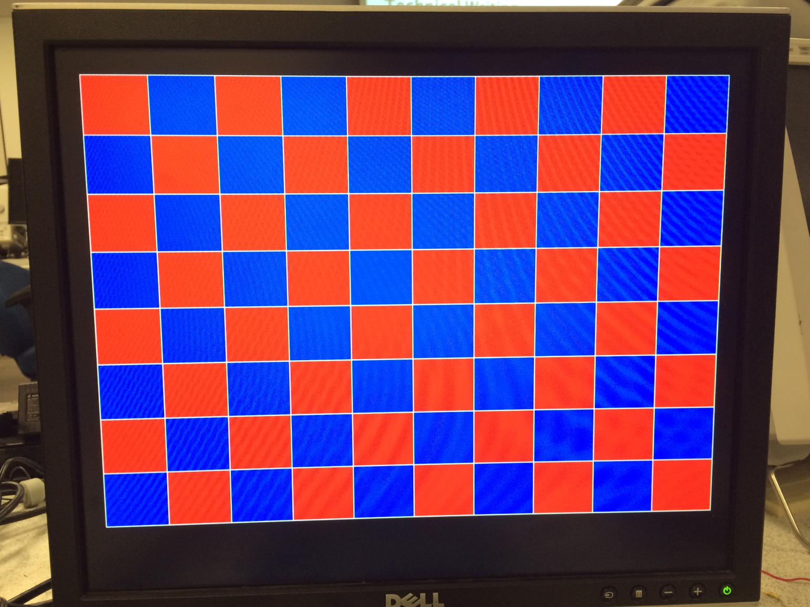
BRAM to Video

Slide 17
2: Updating BRAM
Marker needs to be show at the top so users know which column they’re using
Must fill according to the rules of the game
Colors need to alternate

Slide 18
Updating BRAM
Marker:
10 possible locations which correspond with the column indexes
NOT stored in BRAM
Marker index can be changed with left and right button presses.
When “Video” references a pixel within the index location, yellow is drawn to that pixel

Slide 19
Updating BRAM
Create 10 “fill” signals; one for each column.
The fill signals keep track of which row the program should write to next
As the user is choosing the column, the program is referencing the row to write to if the user finalizes that row. Then the color switches from red to blue.

Slide 20
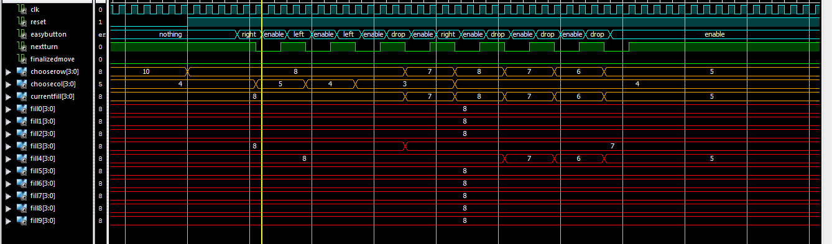
Updating BRAM
Fill signals

Slide 21
Updating BRAM debugging
Debouncing
To fix this issue, the top button must be pressed in between either the left, center, and right buttons.
Overwriting
An enable/disable signal needed to be created from the FSM so that after a move was made, other columns were not changed

Slide 22
3: Winning Logic
Second BRAM created
Checked after every move was made
FSM was paused during this process
Only boxes around the spot a piece was just placed were checked.

Slide 23
Winning Logic
Identical BRAM created
Same writing input signals as the first BRAM
Reason: it is impossible to read from different indexes at the same time. Need to read for visual and winning logic.

Slide 24
Winning Logic
Ripping BRAM:
Need to save the values of the surrounding boxes (21) in separate signals to compare them at the same time.
Unfortunately, can only read from BRAM serially
Mini FSM was built to go through all of these addresses and obtain the data held there.
Relative addressing used
Pause master FSM during process

Slide 25
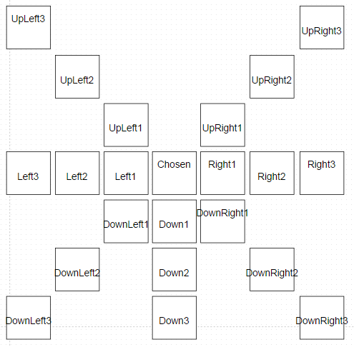
Winning Logic
Relative Addressing:

Slide 26
Winning Logic
13 possible winning combinations of boxes:
4 across
8 diagonal
1 vertical
Checked with combinational logic

Slide 27
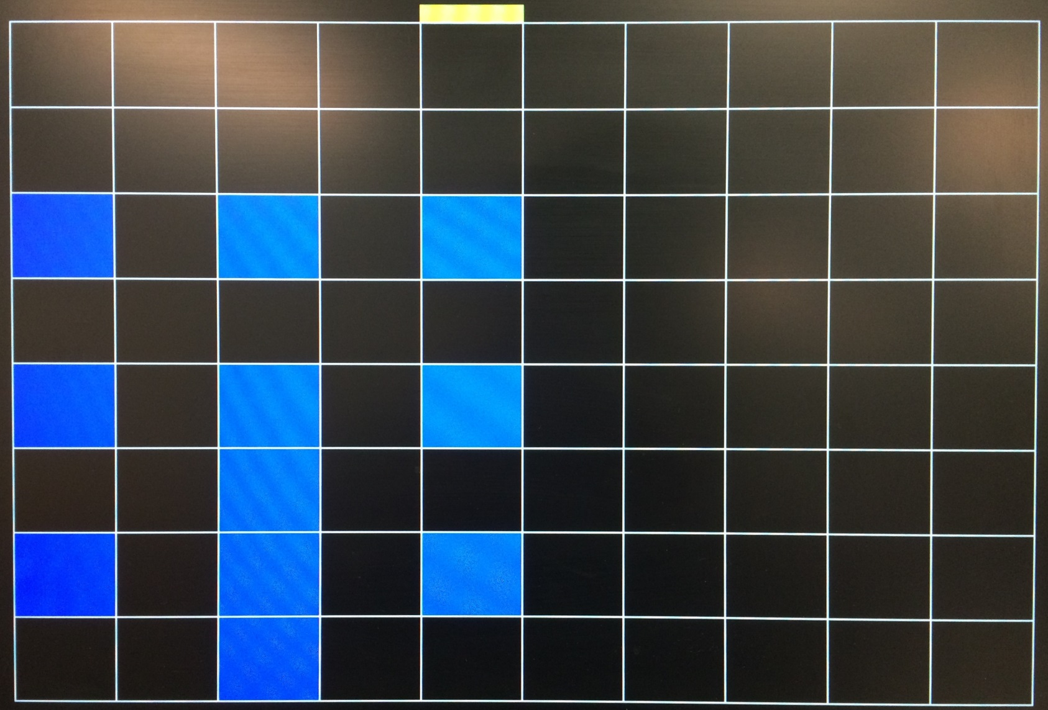
Winning Logic
Displayed on the Screen

Slide 28
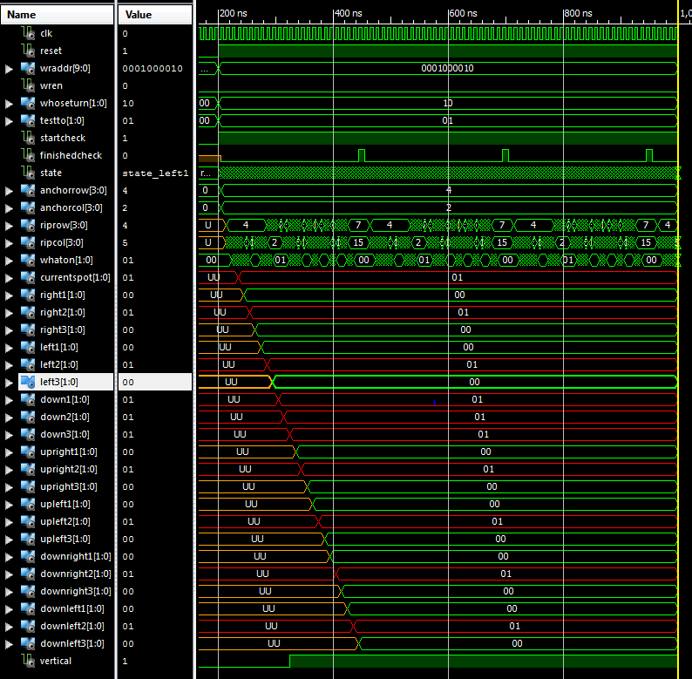
Winning Logic
Testbench
Red signals
Got ripped
From BRAM
And stored in
Signals

Slide 29
4: Decoding the IR Signal
Long highs are 1’s, short highs are 0’s.
Timing determined using counters and clock cycles.
Shift register used to collect the bits as they were translated.
Compiled bits were converted into button presses so game could be played as before.

Slide 30
Decoding IR Signal
Start bit, short highs, long highs.

Slide 31
Decoding the IR Signal
Using logic analyzer the signals were manually decoded:
Left: | 00000000111111110101000010101111 | 00FF50AF
Center: | 00000000111111110000001011111101 | 00FF02FD
Right: | 00000000111111110111100010000111 | 00FF7887
Top | 00000000111111111010000001011111 | 00FFA05F

Slide 32
Decoding IR Signal
Signal Lengths
 | short high | long high | start bit
average = | 0.5440286 | 1.686629 | 4.537029 | (ms)
std_dev | 0.0022839 | 0.009391 | 0.011942 | (ms)
Clock Cycles Upper | 55441 | 174475 | 459370
Clock Cycles Lower | 53158 | 165084 | 447429

Slide 33
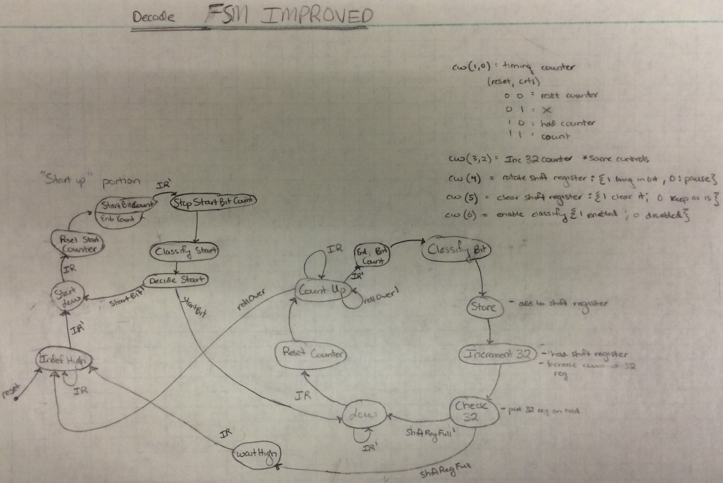
Decoding IR Signal

Slide 34
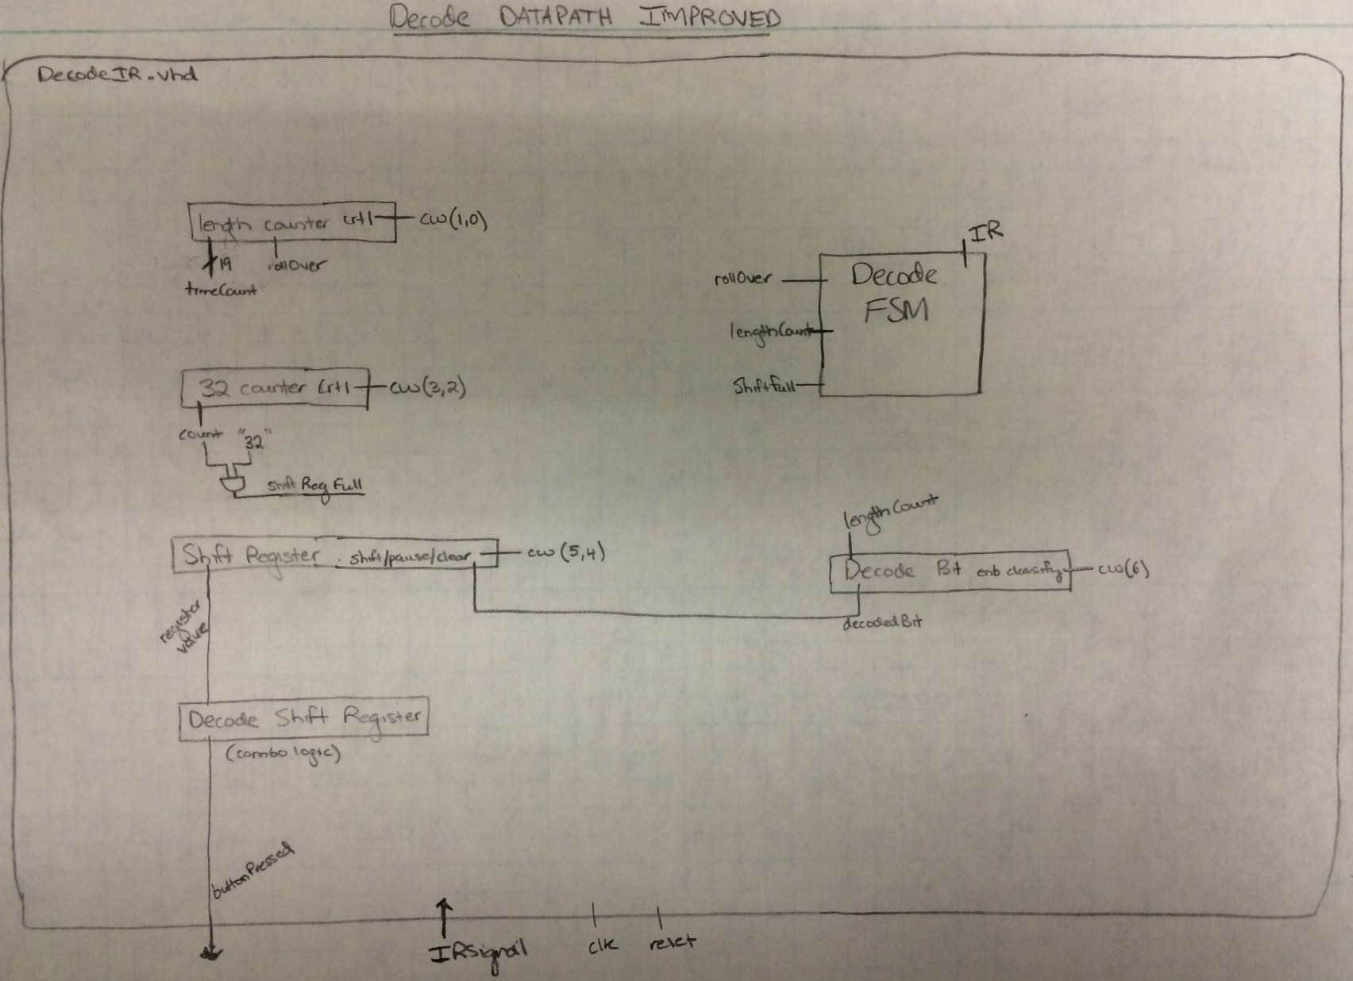
Decoding IR Signal

Slide 35
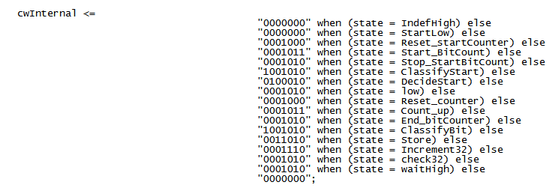
Decoding IR Signal

Slide 36
QUESTIONS?

